Slide 1
Instagram User Analytics
SQL Fundamentals
MySQL Workbench

Slide 2
Overview:
As a data analyst working with the product team at Instagram, your primary responsibility is to analyze user interactions and engagement within the app. By leveraging SQL and MySQL Workbench, you'll extract and analyze Instagram user data to provide valuable insights to the management team. These insights will guide various teams, including marketing, product, and development, in making informed decisions that can drive business growth and enhance the user experience. Your findings will play a crucial role in shaping the future of one of the world's most popular social media platforms.

Slide 3
Project Description:
This project focuses on analyzing Instagram user interactions and engagement to provide valuable insights that can guide business decisions. As a data analyst, your role is to use SQL to extract and analyze data from the Instagram platform, helping various teams—marketing, product, and development—optimize their strategies. The insights derived from your analysis will support decisions related to user retention, engagement, marketing campaigns, and platform improvements.

Slide 4
Purpose:
Marketing Optimization: Identify key user behaviors to help design effective marketing campaigns, such as rewarding loyal users and re-engaging inactive ones.
User Engagement: Provide metrics on user activity and engagement levels to inform both internal teams and external investors.
Platform Integrity: Detect potential fake or bot accounts to maintain the authenticity and quality of the Instagram user base.

Slide 5
SQL Tasks
A) Marketing Analysis:
Loyal User Reward:
Inactive User Engagement
Contest Winner Declaration
Hashtag Research
Ad Campaign Launch:
B) Investor Metrics:
User Engagement:
Bots & Fake Accounts

Slide 6
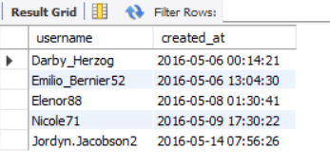
Loyal User Reward:
Task: Identify the five oldest users on Instagram from the provided database.
SQL Code:
select * from users;
SELECT username, created_at
FROM users
ORDER BY created_at ASC
LIMIT 5;
Output:

Slide 7
2. Inactive User Engagement:
Task: Identify users who have never posted a single photo on Instagram
SQL Code:
select * from photos;
SELECT u.username
FROM users u
LEFT JOIN photos p ON u.id = p.user_id
WHERE p.user_id IS NULL;

Slide 8
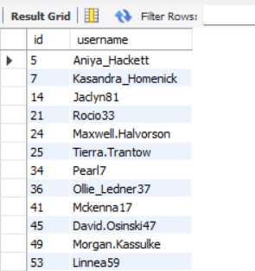
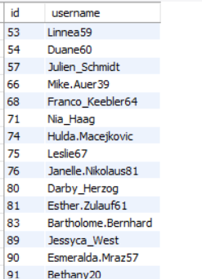
Output:

Slide 9

3. Contest Winner Declaration:
Task: Determine the winner of the contest and provide their details to the team.
SQL Code:
select * from likes;
SELECT u.username, l.user_id ,l.photo_id as likes
FROM users u
join likes l On u.id = l.user_id
order by l.photo_id desc
limit 1;
Output :

Slide 10
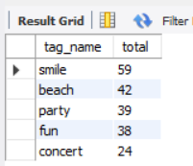
4. Hashtag Research
Task: Identify and suggest the top five most commonly used hashtags on the platform.
SQL Code :
SELECT t.tag_name, COUNT(pt.tag_id) AS total
FROM PHOTO_TAGS pt
JOIN TAGS t ON pt.tag_id = t.id
GROUP BY t.tag_name
ORDER BY total DESC
LIMIT 5;
Output :

Slide 11

5. Ad Campaign Launch:
Task: Determine the day of the week when most users register on Instagram. Provide insights on when to schedule an ad campaign.
SQL Code:
SELECT
DAYNAME(u.Created_at) AS day_of_week,
COUNT(u.id) AS total_users
FROM
USERS u
GROUP BY
DAYNAME(u.Created_at)
ORDER BY
total_users DESC
LIMIT 1;
Output :

Slide 12
B) Investor Metrics:
User Engagement:
Bots & Fake Accounts

Slide 13

User Engagement:
Task: Calculate the average number of posts per user on Instagram.
SQL Code:
SELECT
AVG(posts_per_user) AS avg_posts_per_user
FROM (
SELECT
COUNT(p.id) AS posts_per_user
FROM
photos p
GROUP BY
p.user_id
) AS subquery;
Output :

Slide 14

Task: provide the total number of photos on Instagram divided by the total number of users.
SQL Code:
SELECT
COUNT(p.id) / COUNT(DISTINCT p.user_id) AS total_photos_per_user
FROM
photos p;
Output :

Slide 15
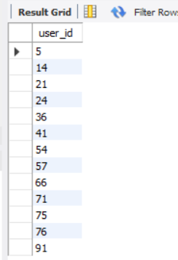
Bots & Fake Accounts:
Task: Identify users (potential bots) who have liked every single photo on the site, as this is not typically possible for a normal user.
SQL Code:
SELECT
l.user_id
FROM
likes l
GROUP BY
l.user_id
HAVING
COUNT(l.photo_id) = (SELECT COUNT(*) FROM photos);
Output :

Slide 16


